Slide 1
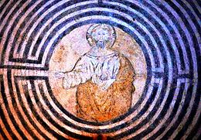
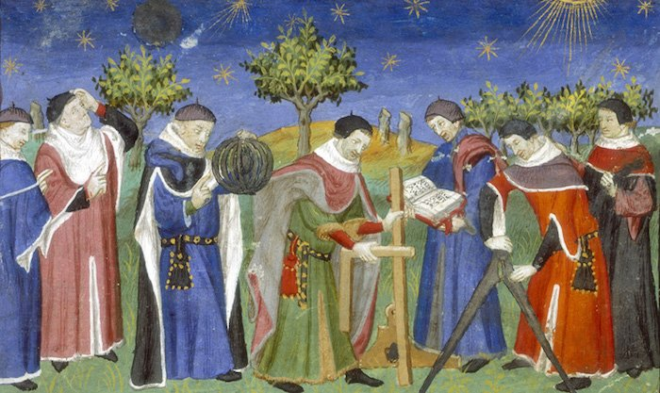
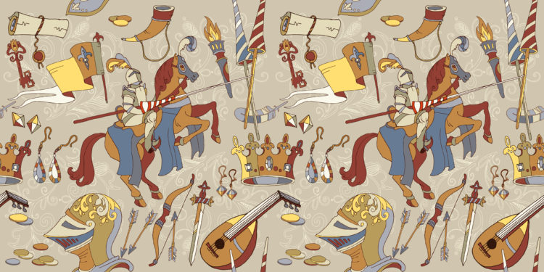
Democracy in the Middle AgeS

Slide 2
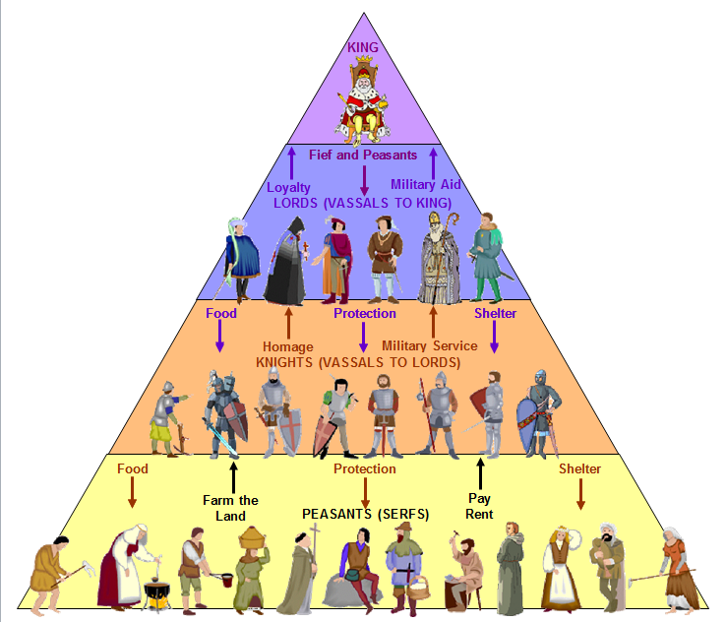
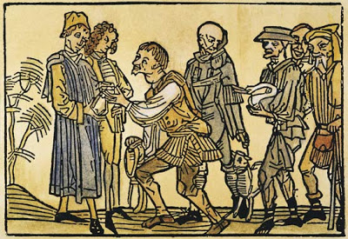
The Middle Ages were characterized by:
monarchy and oligarchy as dominant forms of government;
a feudal type of culture.
But there was also:
the rise of a concept of democracy based on the principles of representation and association among equals, as in the cities known as Communes.
However not all citizens had political rights; many were excluded and this led them to fight against the ruling classes.
An important step towards democracy was the assertion of individual liberties and rights in seminal documents of the age.

Slide 3
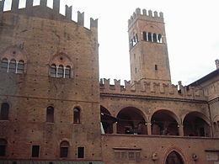
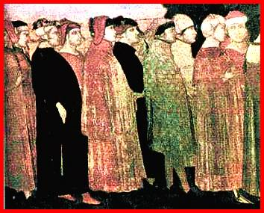
Between the11th and the 12th centuries, communes, or city-states, developed in central and northern Italy.
A commune was a self-governing unit that was indipendent from other states. It was administered by a popular assembly, called parliament.
Bologna: Torre dell’Arengo

Slide 4
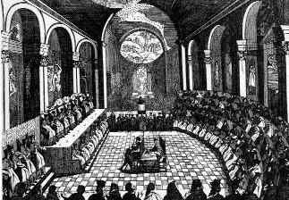
This assembly:
Elected two or more governors called Consuls , and a council of citizens enacting laws , who remained in office for a short time
Appointed court judges for
the administration of
justice.
This procedure allowed all citizens to partecipate in the political life of their city, but only male citizens.

Slide 5
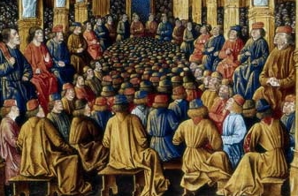
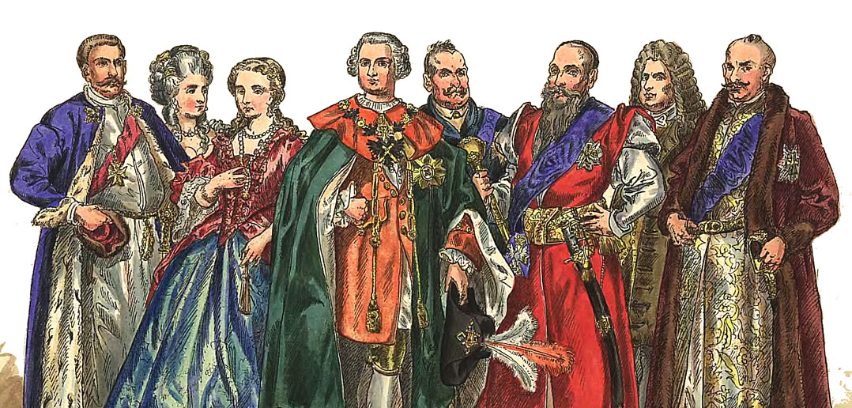
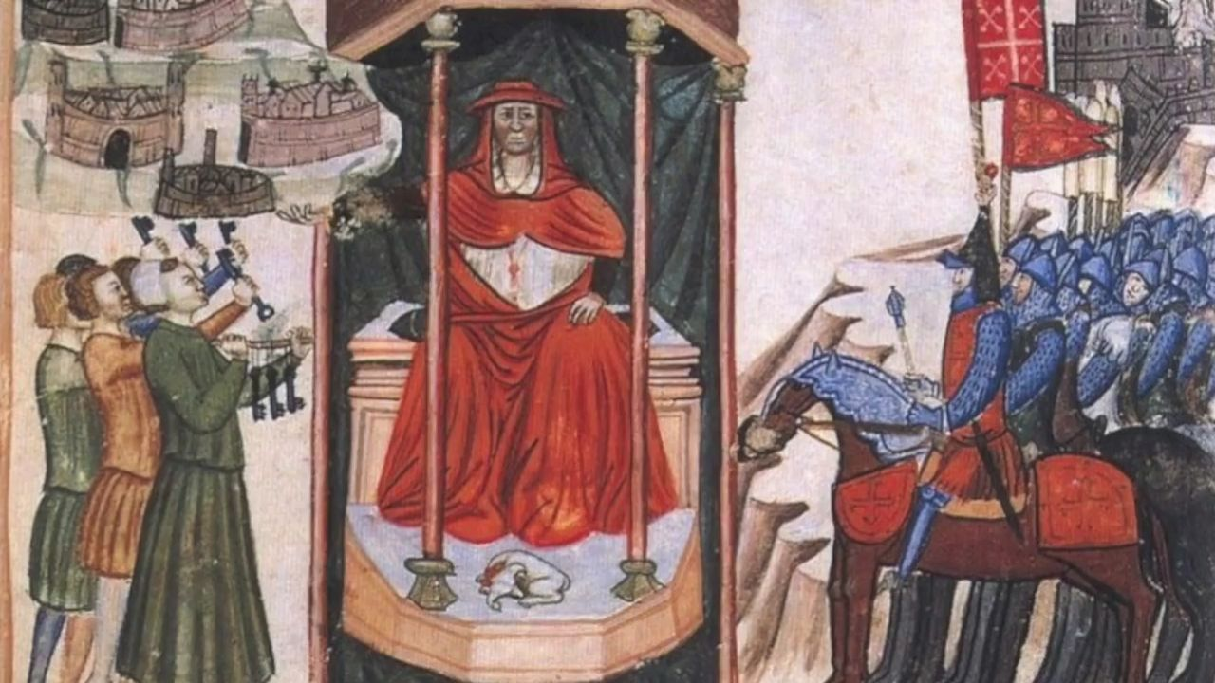
Later Popular assemblies were replaced by smaller groups called major and minor councils formed by lot.
Magistracies were created for a better organization of urban life.
But later the most important offices were held by aristocracy.
Later by a single man,
called podestà.

Slide 6
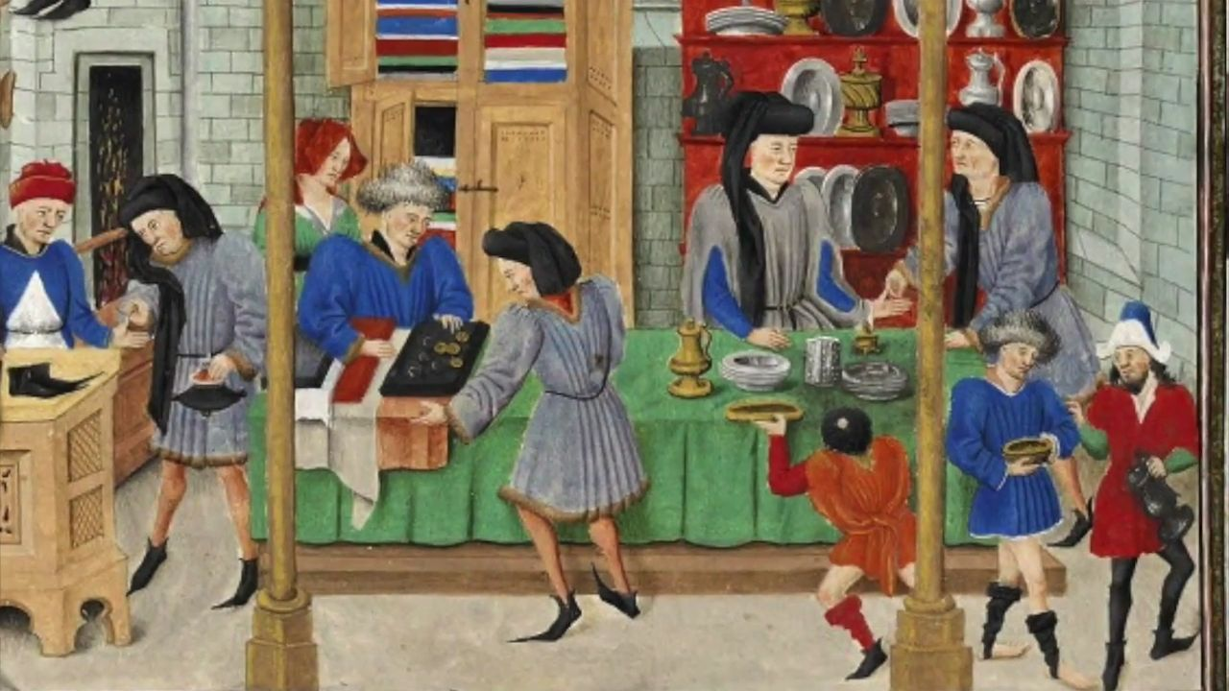
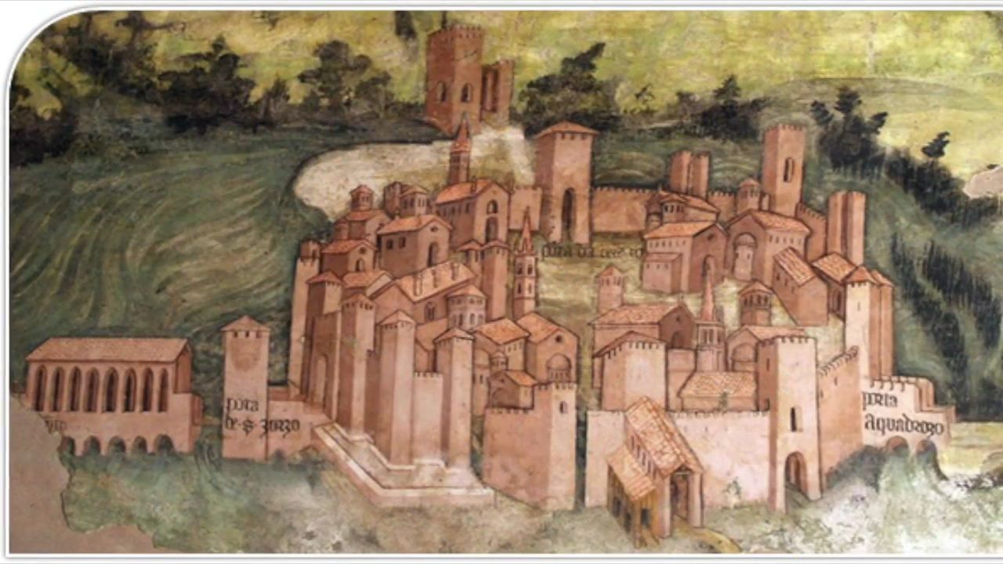
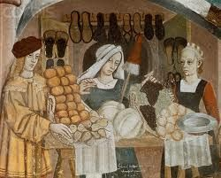
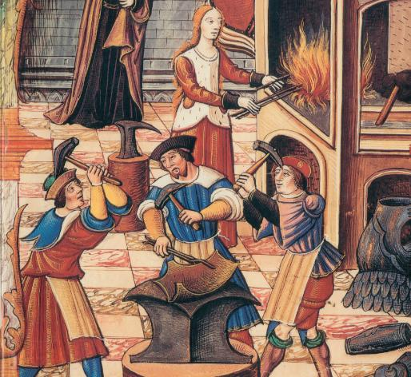
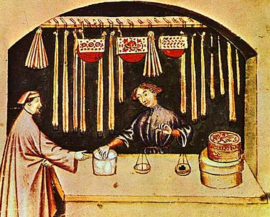
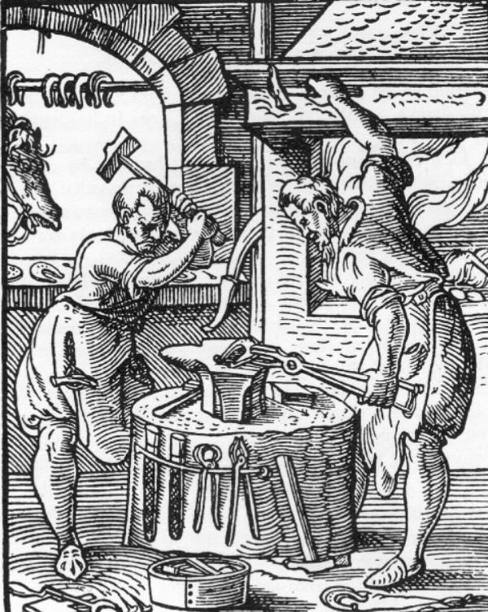
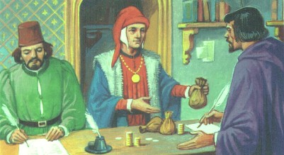
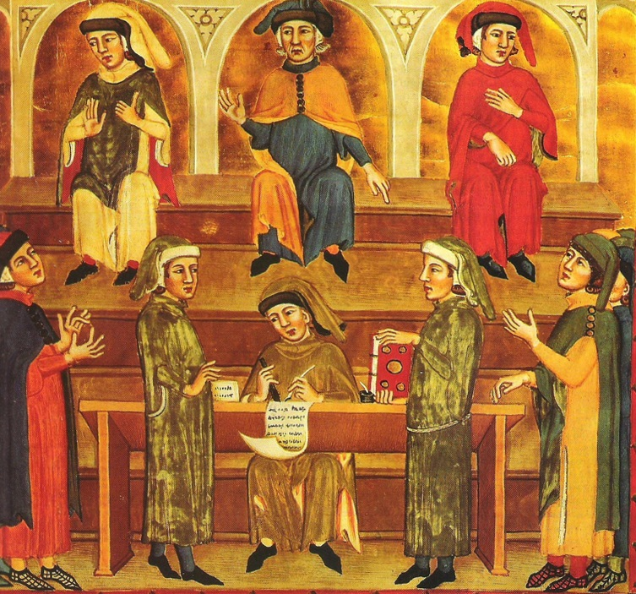
THE BOURGEOISIE
With the economic development of the commune, there was the rise of a new social class, called middle class or BOURGEOISIE.
The term derived from borough, a walled or fortified city inhabited by this new class.
The middle class was made up of :
Merchants
Craftsmen
Shopkeepers
Manufacturers
Bankers
Other professions

Slide 7
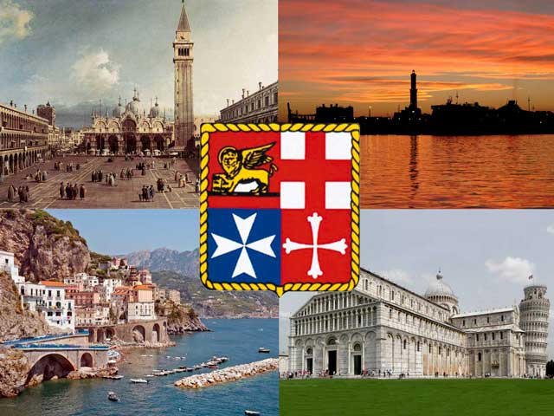
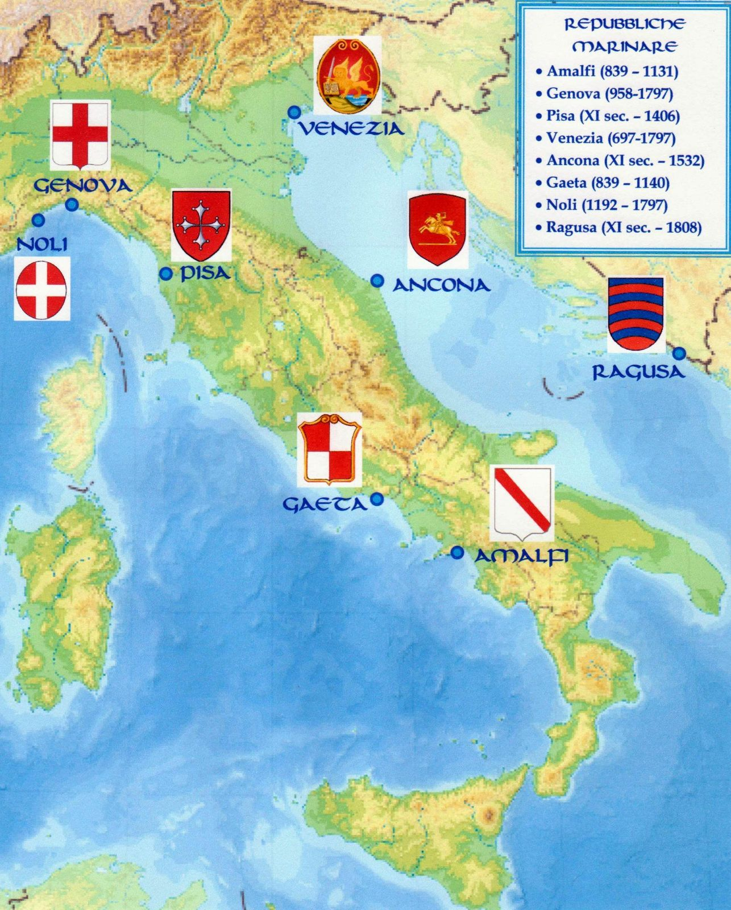
In Italy the most important cities, like the Maritime
Republics, developed their economies and
enjoyed political autonomy through forms of
self-government.
The first Italian communes Milan, Florence , Pisa, Genoa and Bologna became really indipendent fighting against the landowners, asserting their power over the surrounding lands.

Slide 8
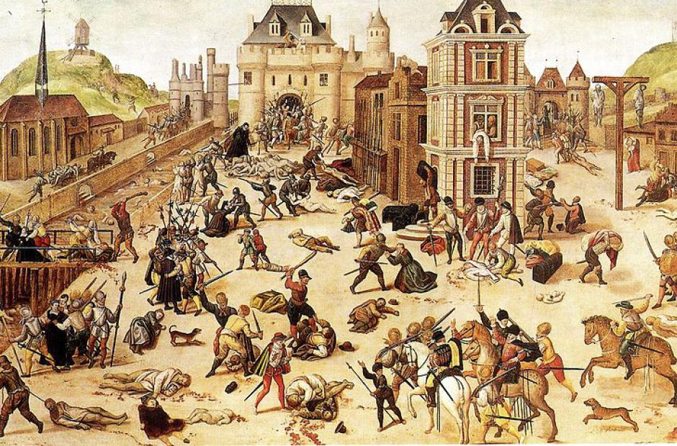
THE REVOLT OF THE CIOMPI
The Revolt of the Ciompi was a popular revolt that took place in Florence in 1378, for social,economic and political reasons.
It led to the creation of a democratic government representing all the classes of the city for a short time (1378-1382).
The Florentine social structure was divided into:
Fat people:
Small people:
Lean people:
Merchants, bankers,
businessmen,
or major guilds
Unskilled workers, small traders and peasants.
A group of wool carders known as CIOMPI.
A lower-middle class, or minor guilds

Slide 9
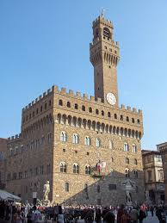
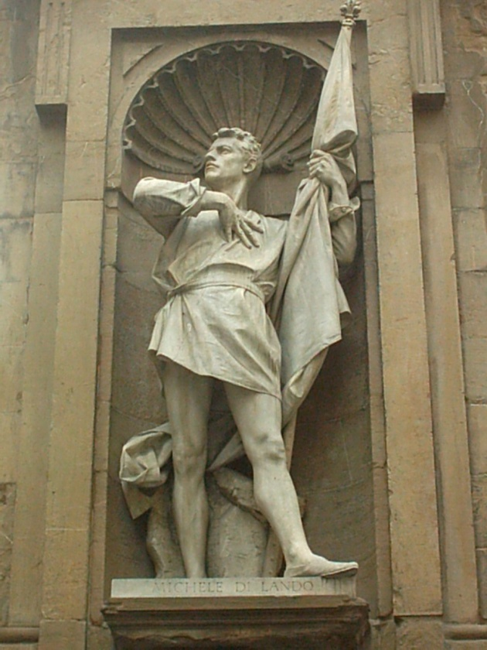
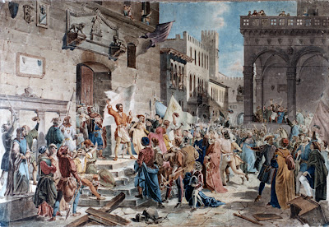
Then they placed the wool carder Michele di Lando as Governor of the Republic.
The Ciompi and other workers :
did not belong to any guilds
did not have political representation
had to pay heavy taxes.
The new govenment created three new guilds:
the Dyers’ Guild
the Shirt Makers’ Guild
the Ciompi Guild
They occupied government buildings like the Priori Palace, and demanded:
- the right to establish
guilds,
- fiscal equity.
Later the major and minor guilds restored the old order and the Ciompi Guild was abolished.

Slide 10
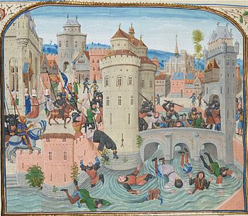
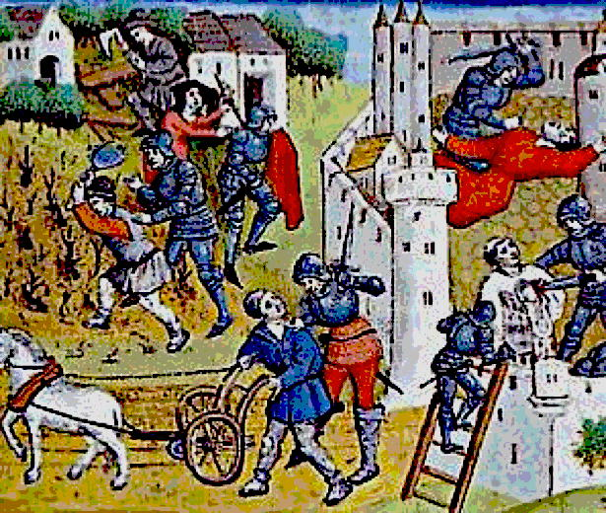
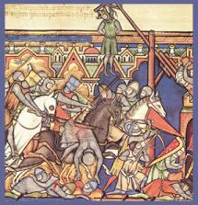
The Jacquerie
The Jacquerie was an antifeudal popular revolt of peasants against aristocracy.
It took place in north-eastern France in 1358.
The causes were:
poverty;
heavy payments;
pillage of mercenaries.
The peasants destroyed castles and killed their inhabitants.
Later, the peasants were defeated and the nobles took revenge by massacring them.

Slide 11
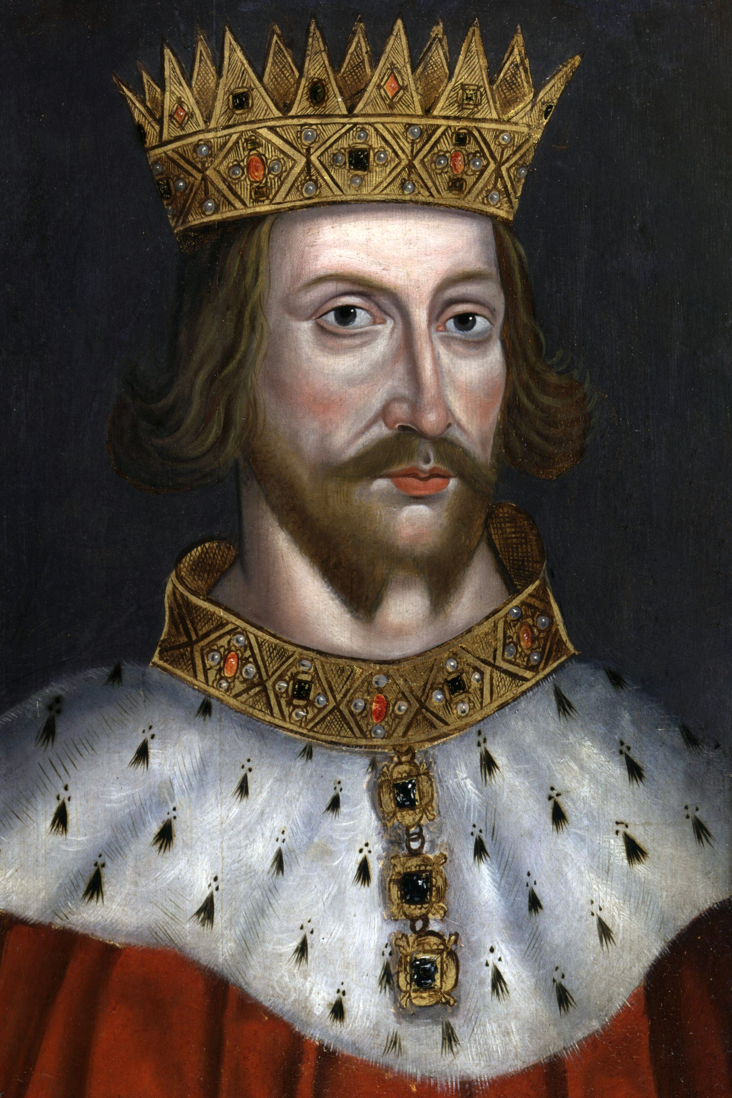
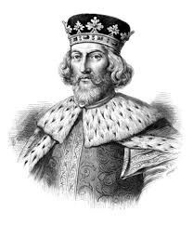
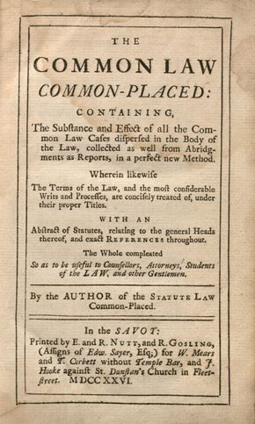
The birth of Democracy in medieval England
King Henry II (1133-1189) made the English judicial system fairer, introducing the Common Law
His son King John (1166-1216) was defeated in the war against France and to finance the war he imposed taxes that increased the barons’ discontent, who occupied London.
A system of law based on custom, previous cases and decisions.

Slide 12
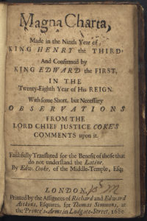
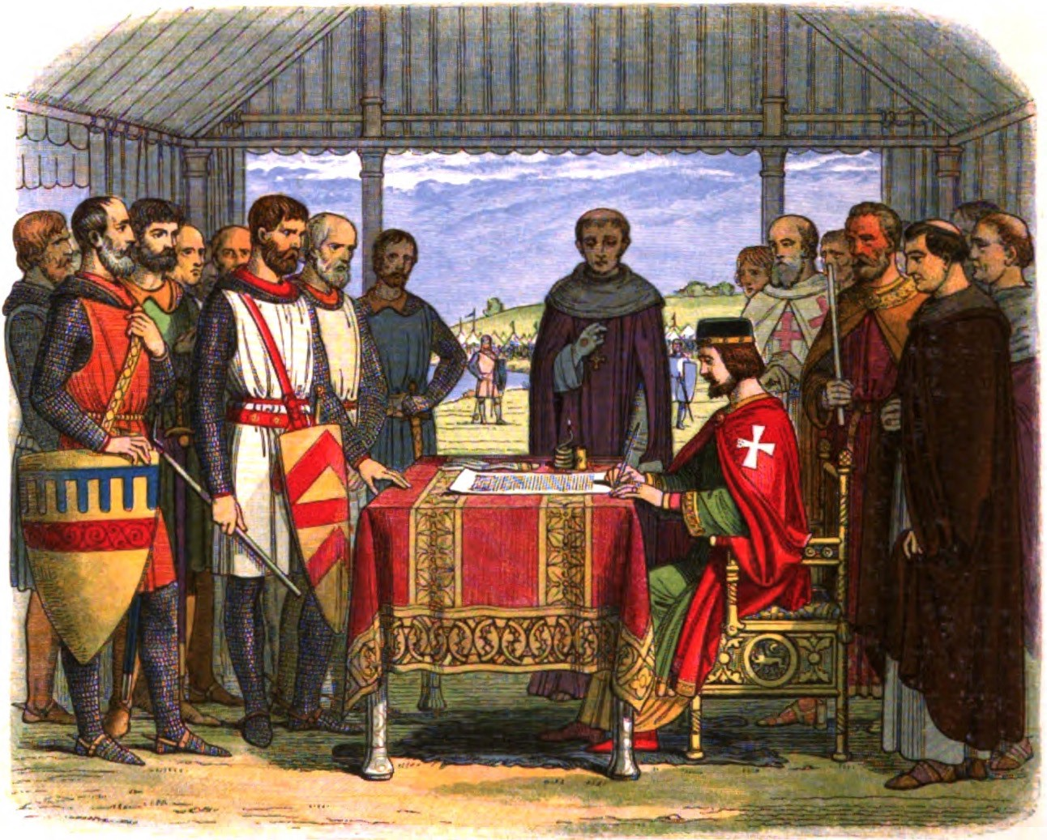
The Magna Charta Libertatum
It limited the power of the king, forbade him to levy taxes without the cosent of nobles and clergy, and guaranteed protection to all free man.
In 1215 king John agreed to sign the Magna Charta or
The Great Charter of Liberty.
It established the rights and liberties of the nobles, the Church and the cities, and respected individual liberty.
Article 39 established that no free man was to be taken, imprisoned or exiled without a fair trial.

Slide 13
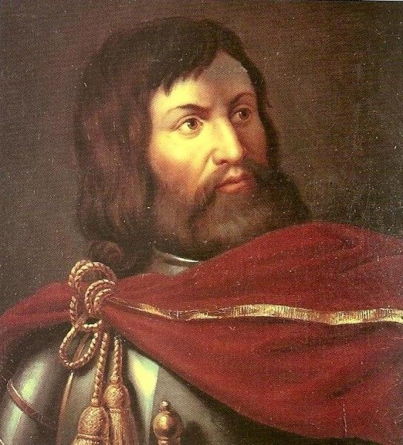
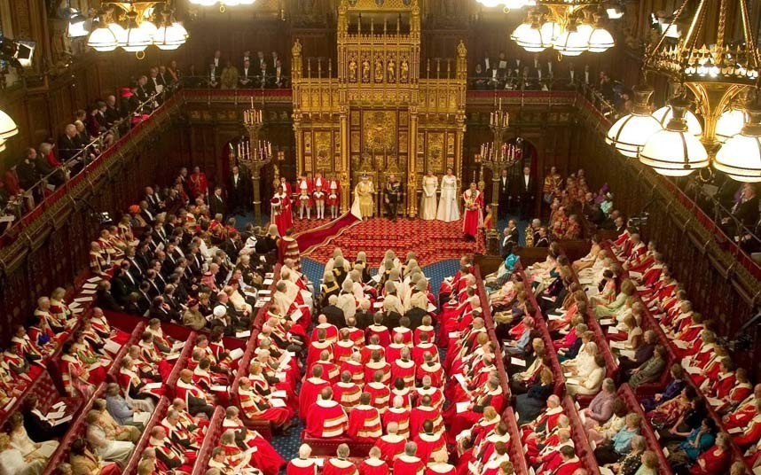
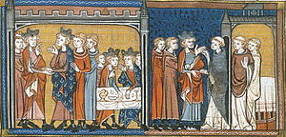
Model Parliament
In 1264-65 Simon de Monfort, the leader of the baronial rebellion against King Henry III, summoned a Parliament which included two knights and two citizens, together with the aristocracy and clergy.
In 1295 King Edward I appointed the first real parliament called Model Parliament.
The important principle that there could be no taxation without representation was introduced.

